Slide 1
Group No. 23
IIT2018001
IIT2018007
IIT2018008
IIT2018031
IIT2018069

Slide 2
Problem Statement
Encrypting a text file with a PGP Public Key

Slide 3
Why to use PGP public key ?
It makes sure that sensitive data like our bank accounts, passwords and/or confidential files will be available only to the designated people.
We encrypt the information and then we can safely store it locally, in the cloud or send via email.

Slide 4
Process Of Encryption:
First of all we need to create PGP key-pair
It’s called a key-pair because there is a pair of keys - private and public
When a file is encrypted (locked) with a Public key it’s considered safe(unauthorized people will not be able to unlock it and read the contents). File can be encrypted with multiple public keys (presuming multiple people areallowed to access the file)

Slide 5
Process of Encryption (continue)
If Alice wants to encrypt file so that only Bob can decrypt it she needs to askBob to send his public key and select only this key when encrypting file
One of the matching Private keys is required to decrypt (unlock) the file.Passphrase is required to use private key
To avoid jeopardizing the whole security idea NEVER share your private keywith other people and DO NOT send private key over the internet

Slide 6
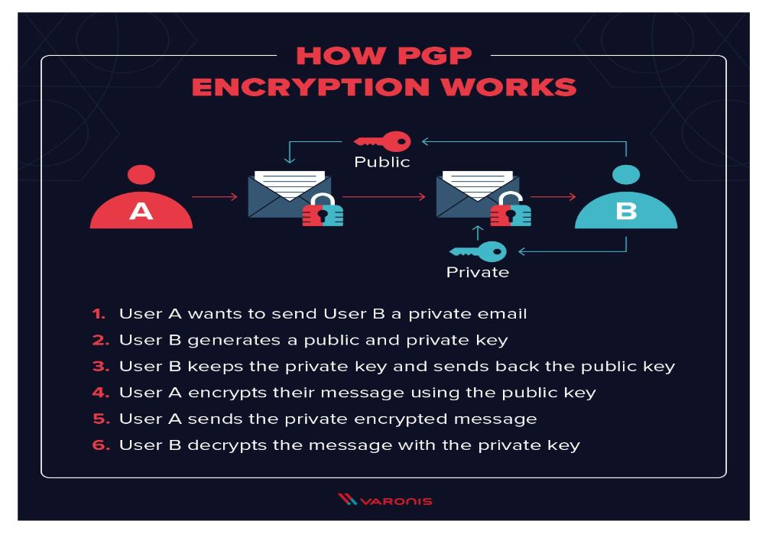

Slide 7
What is OpenPGP ?
PGP stands for Pretty Good Privacy.
Prefix "Open" means that it’s an open standard, many applications support it.
OpenPGP software uses a combination of strong public-key and symmetric cryptography to provide security services for electronic communications and data storage.
These services include confidentiality, key management, authentication, and digital signatures.

Slide 8
How to Encrypt Files with Open PGP ?
1. Get your trading partner’s public key to encrypt the file.
2.Import your trading partner’s public key into a Key Vault.
3.Use your file transfer tool to create a Project to encrypt the file. Sign the file with your private key if required.
4.Confirm that the project was set up correctly before executing.

Slide 9
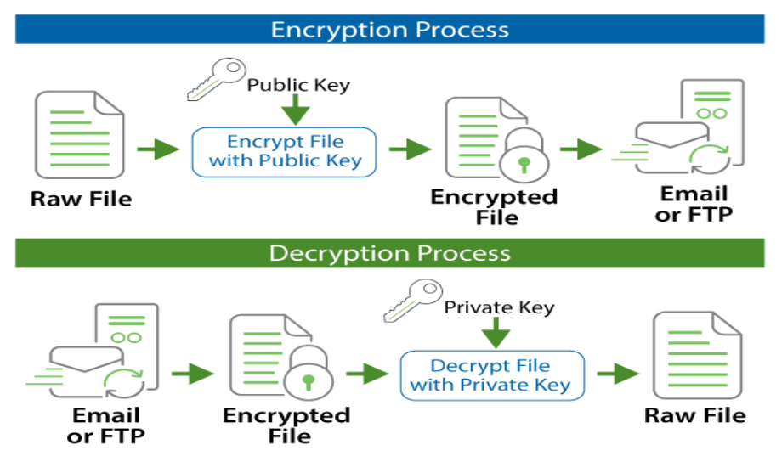

Slide 10
PGP Key Management
Keys are protected and organized into Key Vaults for security access controls. Access the Key Management System through the Encryption menu.

Slide 11
Protecting a File with PGP Encryption
To get started, we first encrypt a file that we can send to our trading partner. We will need our trading partner's public key to encrypt the file. Our trading partner will use their private key to decrypt the file once it is received.

Slide 12
Signing a File:
1.To add a signature, expand the Secret Key panel and select the Add a Secret Key option.
2.On the Key Name field, select your private key and enter the Password of the key. If you do not have a private key, you can create one in the Key Vault.

Slide 13
Precautions while encryption:
You should always verify the hash of the file with the recipient or sign it with your private key, so the other person knows it actually came from you.
If there is a man-in-the-middle, then he/she could substitute the other person's public key for his/her own and then you're screwed. Always verify the other person's public key (take a hash and read it to each other over the phone).

Slide 14
Thank you !

